Slide 1

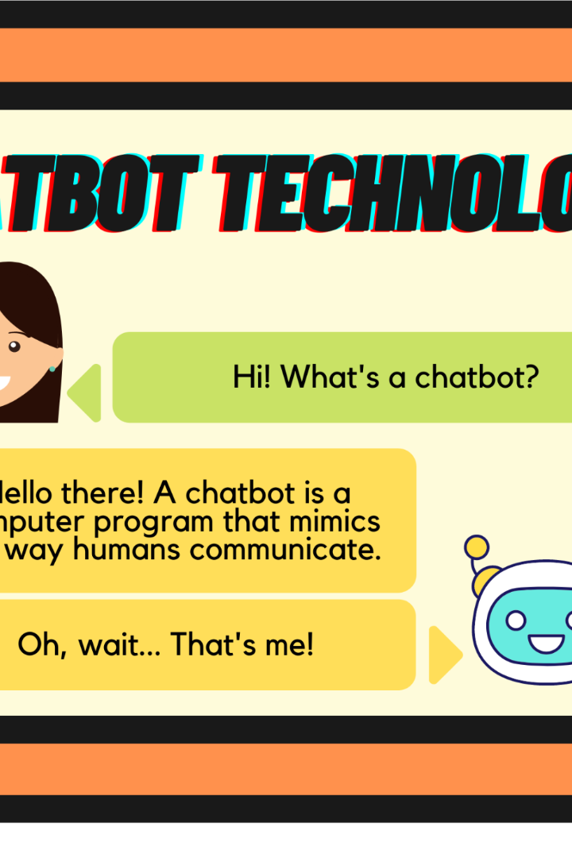

ChatGPT: A Concise Overview
ChatGPT, powered by OpenAI's GPT architecture, is an advanced conversational AI chatbot. It utilizes a transformer-based neural network to generate human-like text based on input.

Slide 2
Key Aspects of OpenAI
1
Founding and Leadership
2
Mission and Principles
OpenAI was founded in December 2015 by prominent figures such as Elon Musk and Sam Altman. It initially received a pledge of $1 billion in funding.
OpenAI's mission is to ensure the benefits of artificial general intelligence (AGI) reach humanity. It prioritizes safety, conducts research, and collaborates with other institutions.
3
Research and Development
4
GPT Series
OpenAI is renowned for its contributions to AI research, including the development of GPT-3, one of the most advanced language models.
The GPT series, including GPT-3, demonstrates OpenAI's achievements in language models. With 175 billion parameters, GPT-3 is one of the largest models ever created.

Slide 3
Ethical Considerations
1
Safety and Ethics
2
Collaboration and Engagement
OpenAI places a strong emphasis on safety and ethical AI development. It actively addresses risks associated with AGI and promotes transparency in its endeavors.
OpenAI actively collaborates with research and policy institutions, fostering a cooperative community dedicated to responsible AI advancement.
3
Funding and Structure
4
Applications and Impact
Operating as both a for-profit and non-profit organization, OpenAI receives funding from various sources to support its research and initiatives.
OpenAI's research has had a significant impact on natural language understanding, text generation, and other areas of AI research, driving advancements in the field.

Slide 4
ChatGPT: A Closer Look
1
GPT Architecture
2
Two-Step Process
GPT is built on a powerful transformer-based model, allowing it to excel in processing sequential data. Pre-training enables it to learn grammar and context.
ChatGPT works through a two-step process of pre-training and fine-tuning. It is pre-trained on a vast dataset from the Internet, acquiring grammar, facts, and reasoning abilities. Fine-tuning narrows down behavior and enhances usefulness and safety.
3
Learning from Mistakes
4
Safety Mitigations
ChatGPT improves its behavior through a combination of pre-training and fine-tuning. It does not learn in real-time from user interactions, but rather leverages diverse internet text and human reviewers to address potential pitfalls.
OpenAI implements safety mitigations to prevent the model from responding to harmful instructions or exhibiting unsafe behavior. Technical measures and thorough guidelines for reviewers contribute to responsible AI development.

Slide 5

Versions and Differences
GPT-2
ChatGPT (based on GPT-3)
GPT-3 and GPT-3.5 Turbo
OpenAI's GPT-2 model was a significant milestone, showcasing the organization's advancement in language models.
ChatGPT, based on GPT-3, is fine-tuned for conversational applications, enabling it to generate contextually relevant and coherent text.
GPT-3, with its massive 175 billion parameters, is one of the largest language models created. Additionally, OpenAI introduced the GPT-3.5 Turbo variant, optimizing the model for specific use cases.

Slide 6

Factors Contributing to Differences
1
Model Size
Larger models, such as GPT-3 with 175 billion parameters, have the capacity to capture more complex patterns and nuances in data, enhancing their capabilities.
2
Training Data
Each GPT version is trained on diverse datasets, which shape their understanding of language and context, allowing them to generate more contextually appropriate responses.
3
Fine-Tuning and Optimizations
Versions like ChatGPT are fine-tuned for specific use cases, tailoring their behavior and performance to meet the requirements of particular applications.

